Slide 1

LONDON
Tourism Analysis
SHUWEI DENG
ZHIHONG LENG
MENGQI LI
JEEVANANDHAN RAMAMOORTHY

Slide 2
Contents
01
02
03
04
Part one
Part two
Part three
Part four
Problems & Datasets
Descriptive analysis
Models
Findings

Slide 3
Problems & Datasets
What are the spending and visiting patterns of London’s tourists?
The differences between EU nations and non-EU nations on their spending and visiting patterns in London.
What are the main factors that contributed to the tourists overstay?
Tourists from which countries have the highest probabilities of overstay?
54,628
Observations
96
Variables
Data Source:
London Datastore: International visitors london.csv
Legatum Institute Foundation: Prosperity.csv
World Bank Group: GDP.csv
Tool Used:
R, Python, Tableau

Slide 4
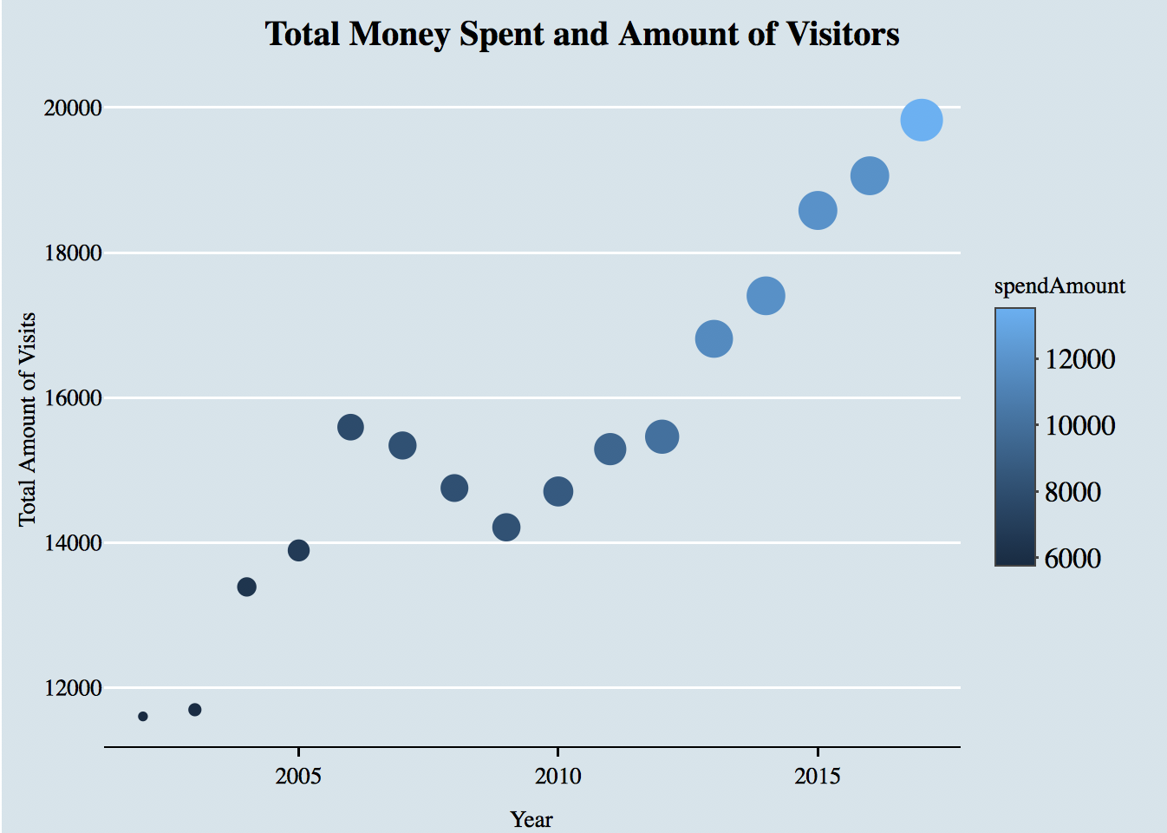
Total Money Spent and Amount of Visitors
The bigger/lighter the dots, the greater the number of money spent.
General Trend of Visitors is increasing.
General Trend of Spending is increasing.
Decline for number of Visits for year 2006 and 2009.

Slide 5
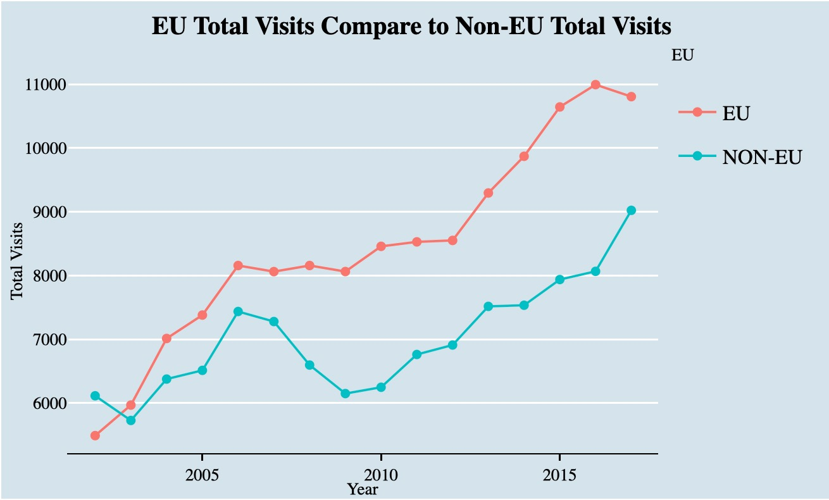
Total Visits of EU vs. Non-EU
64 countries in total
EU: 19 Countries
Non-EU: 45 Countries
The number of visitors from Non-EU are ALWAYS MORE than the number of visitors from EU.
The number of visitors from BOTH EU and Non-EU countries increased over the years.
The number of visits from Non-EU dropped from 2006 to 2009.

Slide 6
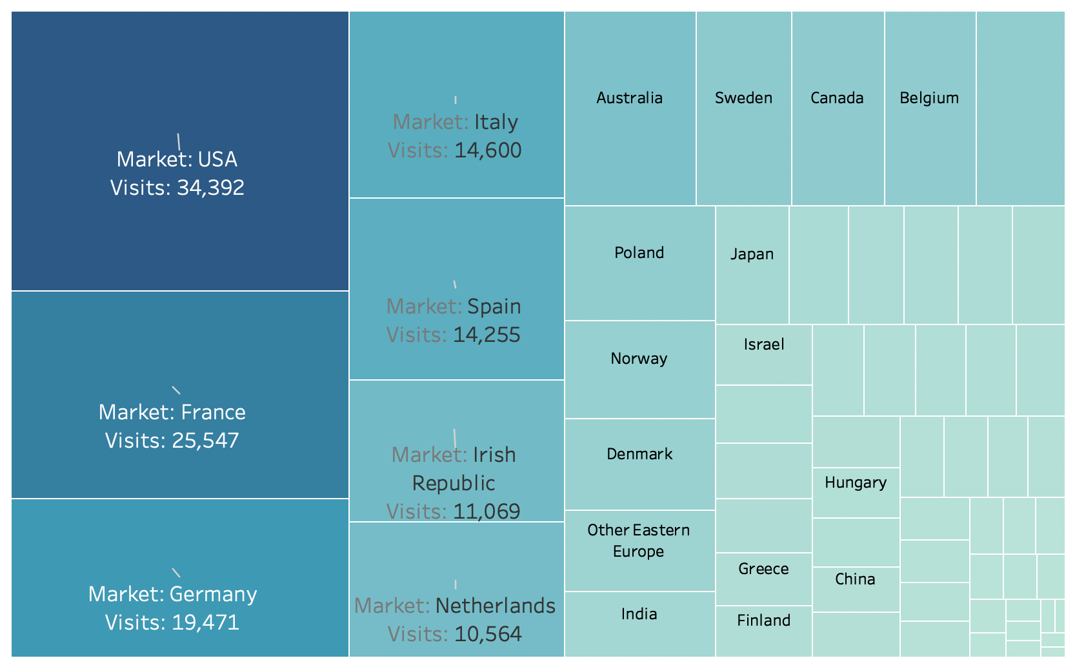
Number of Tourists from Different Countries
USA, France, and Germany have the leading number of tourists in London.
Most countries on the top of the list are EU nations except for USA and Australia.

Slide 7
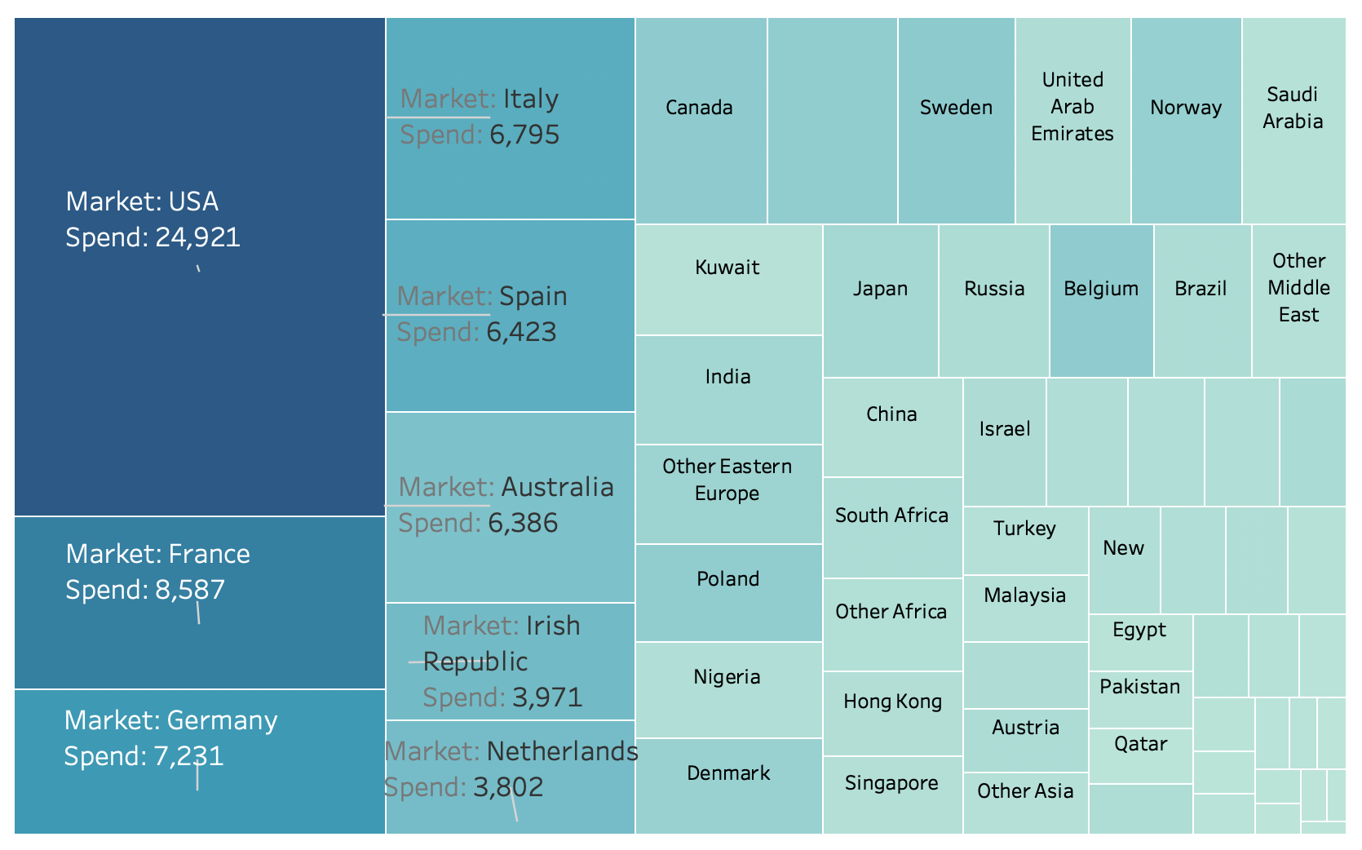
Total Spending of Different Countries
USA, France, Germany are the top 3 countries that spent the most number of money in London.
The money spent by tourists from the USA is almost triple the amount of money spent on tourists from France.
The top 5 countries that have the biggest number of visits have the corresponding spending power.

Slide 8
Model Champion
Gradient Boosting Model: Accuracy 81.81%
Predicted
False Negative in this case means, the model indicates tourists will NOT stay over 15 days, but they actually overstayed.
Minimize the False Negative rate while not dramatically increase the False Positive prediction.
Negative
Positive
Positive
382 | 129
691 | 1991
1073 | 2120
Actual
Negative
Total
False Positive rate: 0.2576
False Negative rate: 0.2524

Slide 9
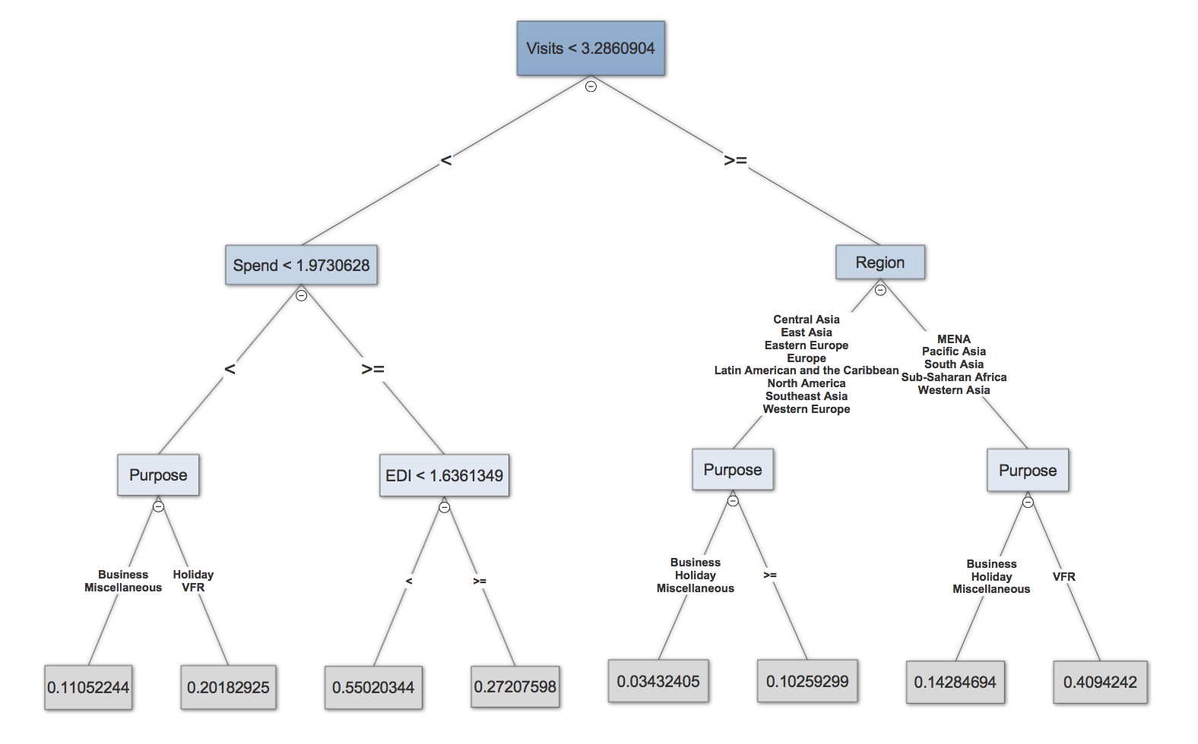
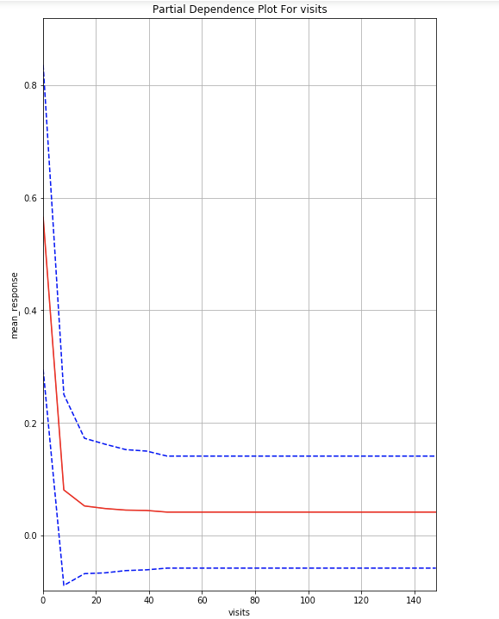
Decision Tree Surrogate Model
The tree surrogate model mimics the GBM model in how the model categorizes the data into different probabilities.
The number of visits is the most important variable when predicting if a person is going to overstay.
The more the visits, the less likely they will overstay.

Slide 10
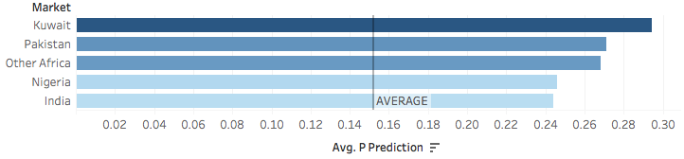
Findings
Travelers from USA, France, Germany are the top 3 groups that spent the most amount of money in London.
Visitors from EU nations are MORE than visitors from Non-EU nations in general, visitors from BOTH EU and Non-EU countries increased over the years.
Visits, Spend, Purpose are the most important factors when determine if a person is going to overstay.
The countries that have the highest probabilities of overstay in London:
Solutions
Visit: Have restrict rules for Visa application process and tighten the customs inspections for the countries that have high probability of overstay. Encourage people visiting more often and staying shorter period.
Spend: Limit the money the tourists can bring during their trips.
Purpose: Make notes on those tourists who stayed longer than the visa issued time. Especially for the tourists that have visits <3.286, spend < 1.9731, and EDI < 1.6361.

Slide 11
THANKS!
QUESTIONS?

Slide 12
Appendix

Slide 13
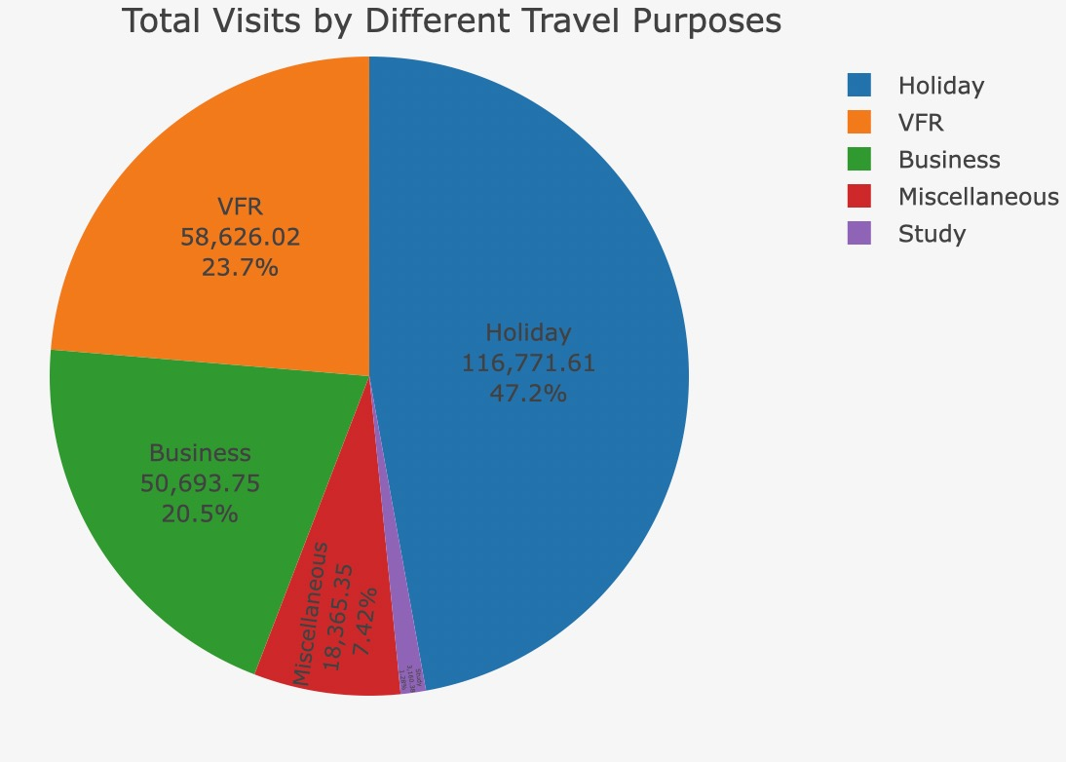
Total Visits by Different Purposes
Business: 20.5%
Holiday: 47.2%
VFR: 23.7%
Miscellaneous: 7.42%
Study: 1.2%

Slide 14
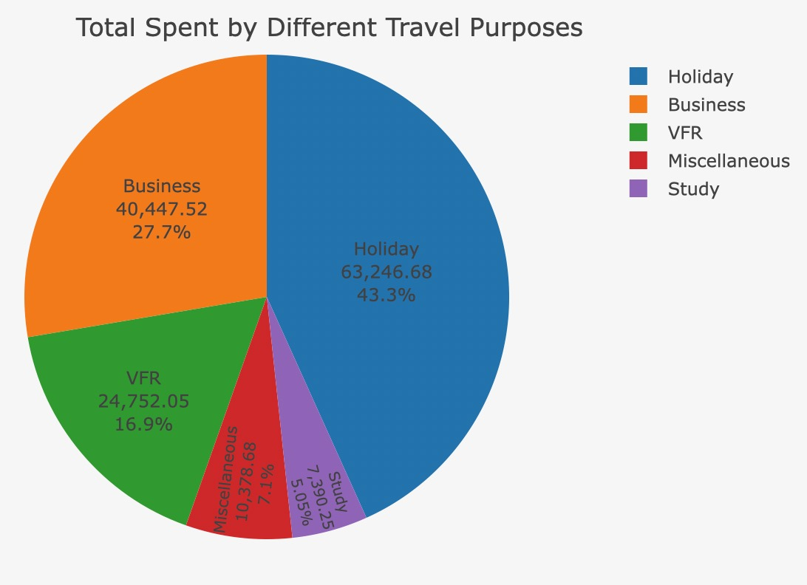
Total Spending by Different Purposes
Business: 27.7%
Holiday: 43.3%
VFR: 16.9%
Miscellaneous: 7.1%
Study: 5.05%

Slide 15
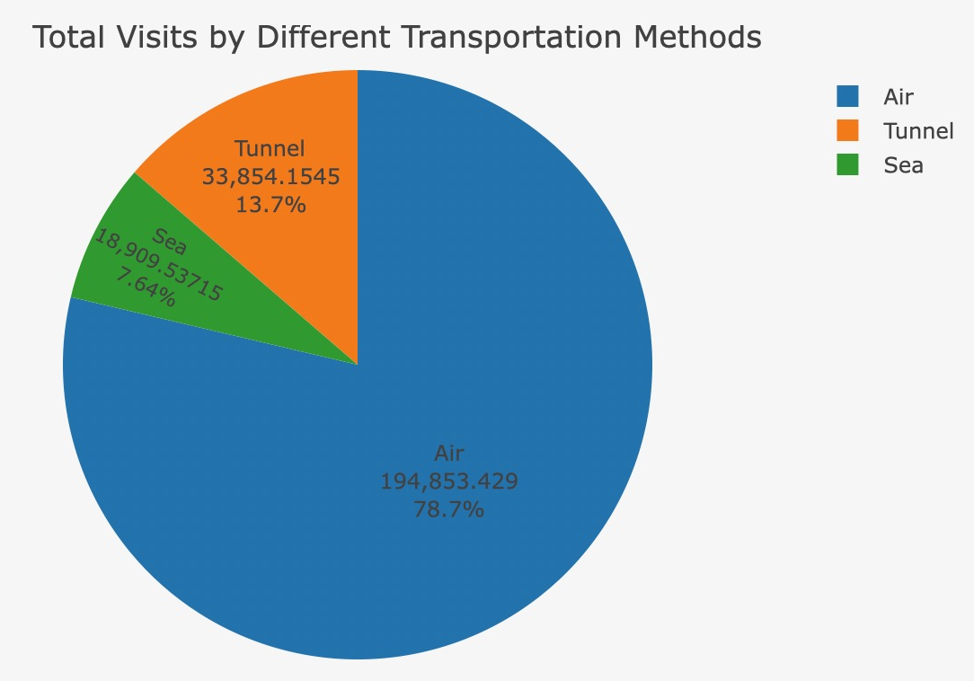
Total Visits by Different Transportations
Air: 78.7%
Tunnel: 13.7%
Sea: 7.64%

Slide 16
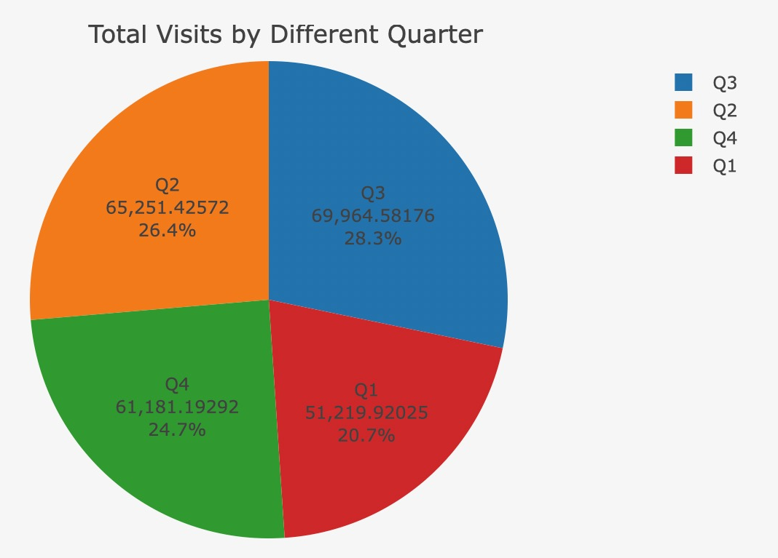
Total Visits by Different Quarters
Q1: 30.7%
Q2: 26.4%
Q3: 28.3%
Q4: 24.7%

Slide 17
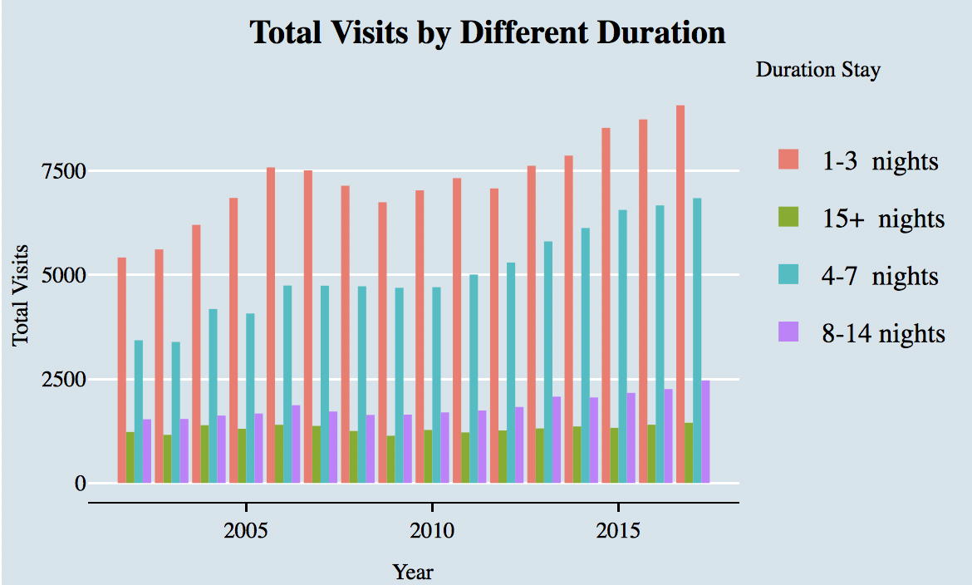
Total Visits by Different Duration
1-3 Nights: 47%
4-7 Nights: 32.7%
8-14 Nights: 11.9%
15 + Nights: 8.41%

Slide 18
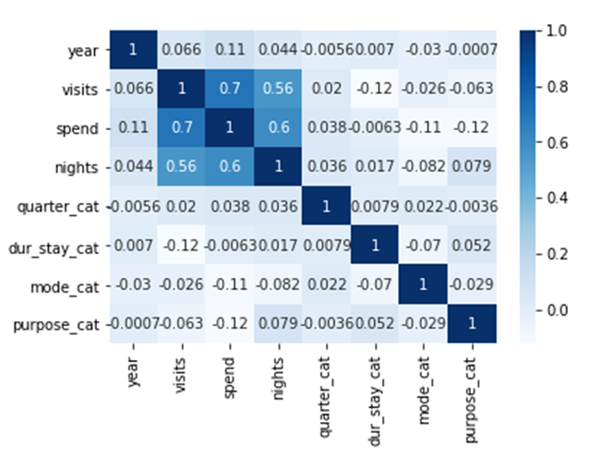
Correlation
We find the correlation for the variables that we think will contribute a lot to the problem.
Visits and Spend , Spend and nights, & Spend and nights have strong positive correlation. Duration of stay and visits have the strongest negative correlation
We excluded “nights”, because it is common knowledge that nights and duration of stay basically have the same meaning.

Slide 19
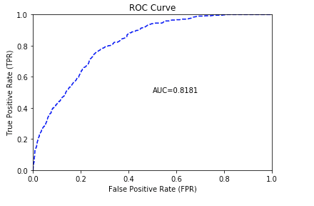
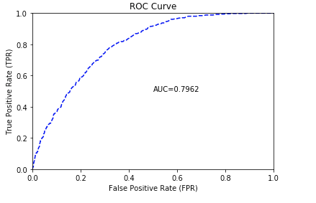
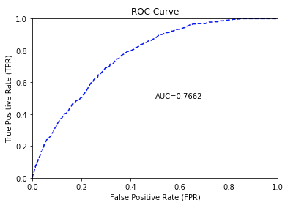
Model Comparison
GBM
→ is a machine learning technique for regression and classification problems, which produces a prediction model in the form of an ensemble of weak prediction models, typically decision trees. It builds the model by allowing optimization of an arbitrary differentiable loss function.
GBM
with balanced target class
→ counts via over or undersampling for imbalanced data. The default is FALSE.
Random Forest
→ an ensemble learning method for classification, regression and other tasks, that operate by constructing a multitude of decision trees at training time and outputting the classification or regression of the individual trees. Random decision forests correct for decision trees' habit of overfitting to their training set

Slide 20
Partial Dependence Plot
Partial dependence plots show the dependence between the target function and a set of ‘target’ features, marginalizing over the values of all other features (the complement features). Due to the limits of human perception the size of the target feature set must be small (usually, one or two) thus the target features are usually chosen among the most important features
Confidence Interval

Slide 21
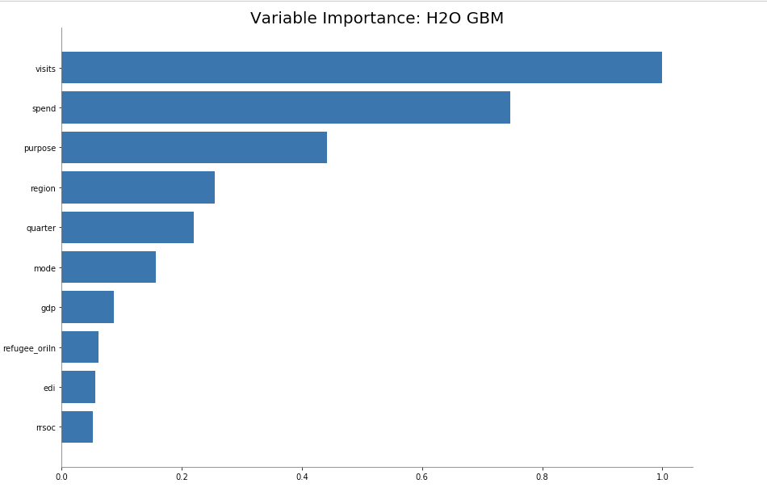
Important variables
The most important variable in the model is “Visits”, followed by “Spend” and “Purpose”.
The more a tourist visit, the higher the possibility that the tourist will overstay.
The more a tourist spend, the higher the possibility that the tourist will overstay.
There are 5 purposes in the dataset, “Business”, “Holiday”, “VFR”, “Miscellaneous”, and “Study”. For example, for study purpose, students will definitely stay over 15 days.
In the model, we excluded “Nights”, because it has very high correlation with the possibility that the tourists from a specific country will overstay.

Slide 22
Region Clarification
Europe Countries: Belgium, Luxembourg, France, Germany, Italy, Netherlands, Denmark, Greece, Spain, Portugal, Austria, Sweden, Finland, Ireland, Switzerland, Norway, Iceland
MENA Countries: Turkey, United Arab Emirates, Saudi Arabia, Bahrain, Kuwait, Oman, Qatar, Syria, Cyprus, Príncipe, São Tomé, Gambia, Algeria, Iraq, Egypt, Israel, Morocco, Libya, Lebanon, West Bank, Yemen, Iran
Eastern Europe Countries: Czech Republic, Poland, Serbia, Bulgaria, Romania, Hungary, Russia, Slovakia, Moldova, Ukraine, Belarus
Western Europe Countries: Liechtenstein, Monaco, Andorra
North America Countries: United States, Canada
Latin America and the Caribbean Countries: Mexico, Brazil, Argentina, Chile, Guatemala, Guyana, Uruguay, Belize, French Guiana, Colombia, Bolivia, Costa Rica, Falkland Islands, Ecuador, Perú, Honduras, Paraguay, Nicaragua, Panamá, Venezuela, El-Salvador
East Asia Countries: Hong Kong, Taiwan, China, Japan, South Korea
Southeast Asia Countries: Malaysia, Thailand, Singapore, Indonesia, Vietnam, Laos, Philippines, Cambodia, East Timor
Central Asia Countries: Kazakhstan, Turkmenistan, Kyrgyzstan, Uzbekistan, Tajikistan
Western Asia Countries: Georgia, Azerbaijan, Armenia
South Asia Countries: Bhutan, Afghanistan, India, Pakistan, Maldives, Sri Lanka, Bangladesh
Pacific Asia Countries: Australia, New Zealand
Sub-Saharan Countries: Africa South Africa, Angola, Mozambique, Nigeria, Kenya, Ethiopia, Eritrea, Togo, Cape Verde, Guinea, Sudan, Cameroon, Burundi, Ghana, Somalia, Central African Republic, Congo (Democratic Republic), Liberia, Mali, Swaziland, Zambia, Namibia, Botswana, Malawi, Congo (Brazzaville), Djibouti, Comoros, Niger, Bénin, Lesotho, Mauritania, Gabon, Madagascar, Rwanda

Slide 23
Tableau Dashboard
https://public.tableau.com/profile/mengqi.li#!/vizhome/londontourism2/colorbypredition?publish=yes

